Slide 1



NAME:RUFINA R.F
BATCH:PGDDM43
Student Result Management System

Slide 2

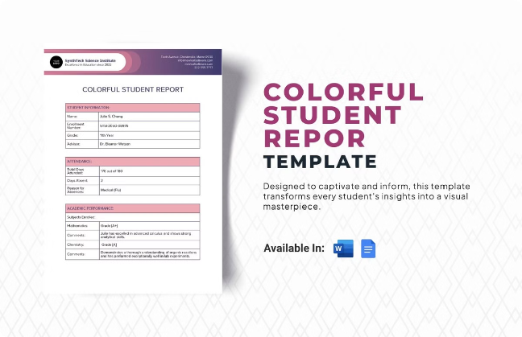
Overview
1
Efficient Operations
2
Improved Communication
The system simplifies the process of managing student data, from enrollment to graduation.
Streamlines communication between teachers, students, and parents, fostering a collaborative learning environment.
3
Data-Driven Decisions
4
Enhanced Transparency
Provides valuable data insights to support decision-making regarding curriculum development and personalized learning.
Offers a transparent and accessible platform for students and parents to track progress and performance.

Slide 3

Features
Student Information
Attendance Tracking
Comprehensive management of student details, including personal information, academic records, and attendance data.
Accurate and timely tracking of student attendance, including absences, tardiness, and leave requests.
Grading and Reporting
Analytics and Insights
Streamlined grading system for assignments, exams, and projects, along with detailed reports for students and parents.
Generates insightful reports and dashboards for educators to analyze student performance, identify trends, and make data-driven decisions.

Slide 4
Student Information Management
Profile Management
Academic Records
Enrollment and Graduation
Provides a secure and efficient way to manage student profiles, including personal details, contact information, and emergency contacts.
Maintains a comprehensive record of student academic progress, including grades, attendance, and course history.
Simplifies the enrollment and graduation processes, ensuring accuracy and efficiency.

Slide 5


Attendance Tracking
1
Real-time Tracking
Allows teachers to record attendance in real-time, providing an accurate and up-to-date record.
2
Automated Notifications
Sends automated notifications to parents and guardians about student absences or tardiness.
3
Attendance Reports
Generates detailed attendance reports for analysis, helping identify patterns and address potential issues.
orientation=horizontal

Slide 6


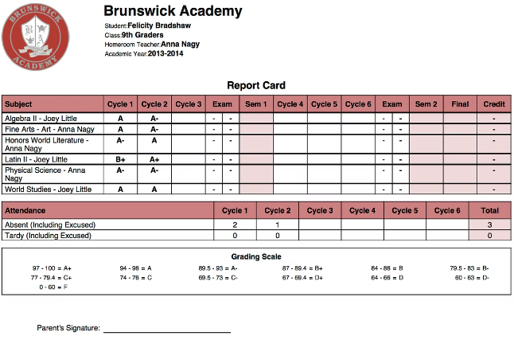


Grading and Reporting
Assessment Management
Allows teachers to create and manage various assessments, including quizzes, exams, and projects.
Automated Grading
Provides tools for automated grading of objective assessments, saving time and effort.
Detailed Reports
Generates detailed performance reports for students and parents, providing a clear picture of progress.
orientation=horizontal

Slide 7
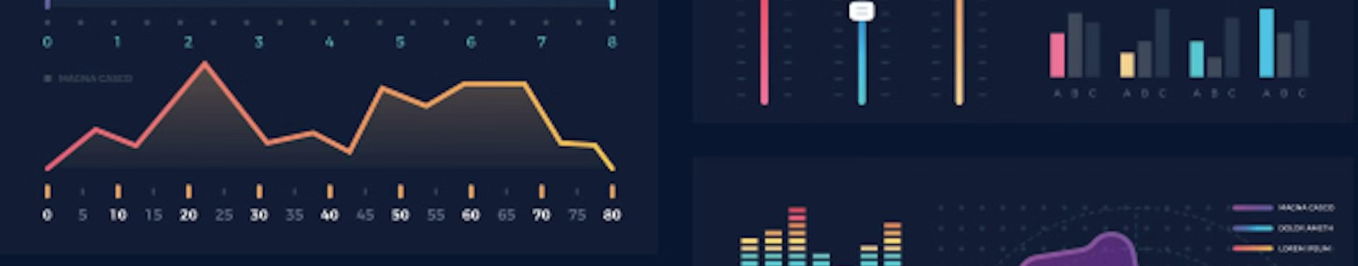
Analytics and Insights
Student Performance Analysis
Provides insights into individual and class-wide performance trends.
Course Effectiveness Evaluation
Helps assess the effectiveness of different courses and curriculum materials.
Early Intervention Identification
Identifies students who may require additional support or intervention.

Slide 8

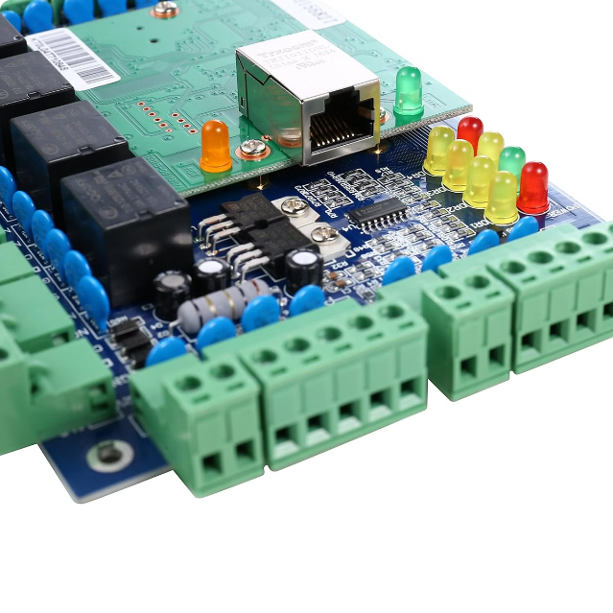




User Roles and Permissions
Teachers
Students
Access to student information, attendance, grading, and reporting tools.
Access to personal information, grades, attendance, and communication channels.
Parents
Administrators
Access to student information, attendance, grades, and communication features.
Overall system management, user role management, and data security control.

Slide 9
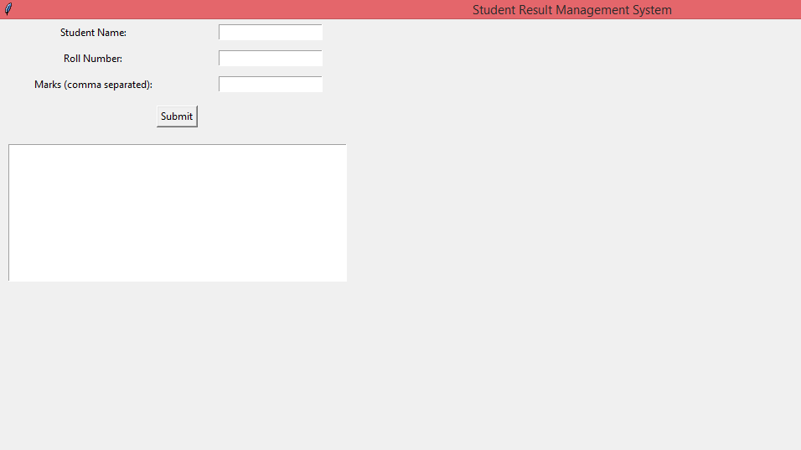
SAMPLE OUTPUT

Slide 10


Conclusion
The student result management system empowers educators with the tools and insights needed to effectively manage student data, enhance teaching practices, and improve student outcomes. By providing a comprehensive and user-friendly platform, the system fosters a collaborative learning environment and contributes to a more efficient and data-driven educational experience.

Slide 11
THANK YOU

